Slide 1
UPK Sites
Salma Bandoo - Final Project

Slide 2
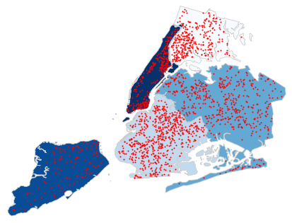
My goal was to see if there was correlation between county income and the amount of UPK sites available.

Slide 3
The data I used allowed me to run this analysis on the county level. I found that there is more of a correlation between population than income.

